Slide 1


CA Application Performance Management Implementation Services
CA Services
May 2013

Slide 2

Your stakeholders asked. CA Application Performance Management delivers.
How do we capture relevant information about root cause? We need timely notifications and resolution!
We have no support for capacity management, so it’s hard to determine peak load – much less monitor trends.
I need centralized performance data to correlate between different components and to view app performance from a single source.
Simplify this for us!
Where are the metrics that can help me identify important performance drivers?
Our customers are affected when we cannot identify key factors in our transactions.
We need to be more effective delivering business services across physical, virtual, cloud and mainframe environments!
- Your CIO
Notes:
Limited capability to capture relevant information about performance root cause, which inhibits timely notifications and resolution of the underlying reasons causing performance degradation.
Incomplete capture of metrics that can identify important performance drivers, which limits the ability to act on data that could improve application performance.
Lack of support for capacity management with limited ability to monitor performance and trends to determine peak load and when it occurs on application services, which restricts the ability to identify performance problems and critical factors affecting the application.
Fragmented performance data that is not centralized, which inhibits correlation between different components to determine performance, and to view overall application performance from a single source.
Incomplete data for business and IT decision-making to monitor the state of the business and critical components. Lack of visibility into stored historical performance data limits the ability to focus, from a business perspective, on opportunities to improve application performance and determine risk areas.
Compromised assessment of customer impact due to the inability to identify key factors in business transactions where customer experience may be impacted, and the associated cost of poor application performance.

Slide 3

What is CA Application Performance Management?
CA Application Performance Management
enables business services delivery and monitoring across physical, virtual, cloud and mainframe environments to optimize application performance.
Modeling of infrastructure
Detailed internal application monitoring
Real-time application health & performance data
Executive dashboards delivered to mobile devices
Optimize integrations
Enhance functionality, augment capabilities
What is it?
Notes:
CA Application Performance Management solutions enable you to deliver business services across physical, virtual, cloud and mainframe environments with reliability and ease. Whether you are an executive who needs tailored dashboards to track overall performance and business impact, or an application support manager seeking the details you need to find and fix complex issues, you gain access to integrated end-user experience information, from application to network to infrastructure, which helps prioritize problem resolution and manage SLAs.
Modeling of infrastructure associated with application to support incident triage and root-cause diagnosis at business application level.
Detailed internal application monitoring from end-user perspective.
Real-time application health and performance data with role-based dashboards tailored to your unique requirements, with visualization and reporting for internal application metrics.
Executive dashboards delivered to mobile devices, ideal for C-Level managers to view real-time health and performance information for key IT services, and key application and infrastructure metrics.
Accelerator Services available to optimize integrations with CA Infrastructure Management and CA Service Operations Insight.
Enhance functionality and augment capabilities while minimizing the effort required for configuration and deployment, while minimizing disruption to your IT operations and staff

Slide 4
Key Benefits
Improve implementation quality | CA Services professionals help overcome business and technology challenges Reduce risk
Improve productivity, time-to-value, ROI | Implementation crafted to meet your unique requirements
Reduce IT costs, errors | Improved delivery of IT Services Resolve critical incidents faster Do more with same resources
Optimize & standardize operations | Automate application performance management tasks Insight to key metrics Standardize performance management, implementation, configuration, reporting
Notes:
Improve implementation quality with CA Services professionals to help you overcome business and technology challenges and reduce risk.
Improve productivity, time-to-value and ROI with an implementation crafted to meet your unique requirements.
Reduce IT costs and errors by providing improved delivery of IT Services, resolving critical incidents in a timely manner, and doing more with the same resources.
Optimize and standardize operations by automating Application Performance Management tasks, providing key metrics, and standardizing performance management, implementation, configuration and reporting.

Slide 5

Overview: Foundation Services
How do I get started?
Notes:
Acceleration Services for CA Application Performance Management are the perfect way to build on the strong foundation of your CA Technologies solutions. Your business environment is like no other, and we respond to your unique needs by…

Slide 6
Foundation & Acceleration Services from CA Services
Get Started
FOUNDATION
Extend Value
ACCELERATION
Success starts with a good foundation: integrated services deliver a tested, preconfigured foundation for rapid solution creation and deployment.
Quickly meet requirements
Speed deployment
Accelerate time-to-value
Extensible, modular architecture offers a common framework for delivery.
Extend the value of your CA Technologies solution by adding functionality to your Foundation implementation.
Acceleration services are designed to provide additional capabilities that can help you build on initial successes.
Notes:
Depending on your desired business outcome, we can help you access your needs and plan a course. We have a flexible, configurable approach to our implementation services. The model enables us to align our solutions, and the delivery thereof, to your specific needs and people, process and budget requirements, while retaining the benefit of pre-defined outcomes.
Each solution has a configurable set of Implementation Services. We start by the laying down the foundation and delivering the essential functionality to address your primary business requirements. This implementation speeds solution deployment, reduces loss of workforce productivity, and accelerates time-to-value to get you up and running quickly.
Then we’ll extend the value of your solution by implementing additional functionality and/or configurations with acceleration services. This might entail enabling features available in the core solution, and/or adding modules, Packaged Work Products, etc.
Our implementation services are based on best practices developed over thousands of projects and through years of experience.

Slide 7
CA Application Performance Management (APM) Foundation/Acceleration Services
Foundation Services
Acceleration Services
A typical CA Application Performance Management foundation services deployment consists of:
CA Introscope®
CA Introscope® Workstation
CA Customer Experience Manager (CEM)
CA Application Performance Management Transaction Impact Monitor
Java Agent and .NET Agent
Environment Performance Agent (EP Agent)
PowerPacks and Extensions
Executive Dashboards Acceleration Services
Enabling Acceleration Services
CA Infrastructure Management (IM) Integration
CA Service Operations Insight (SOI) Integration
CA Application Delivery Analysis Integration
Functionality Acceleration Services
CA HTTP Session Monitor
Deployment Pack for CA Introscope with Citrix
Deployment Pack for CA APM with IBM WebSphere DataPower
Synthetic User Field Pack for CA APM
Deployment Pack for CA APM with IBM AS/400
Deployment Pack for CA APM with Windows PerfMon
Business Activity Monitoring Plug-In for CA CEM
Notes:
CA Application Performance Management foundation services implement and configure base functionality. CA APM foundation services provide an extensible, modular architecture that offers a common framework for delivering a range of application performance management capabilities, and supports 22 PowerPacks and Extensions.
It provides end-to-end monitoring of all transactions for a given business application, modeling of the infrastructure associated with the business application to support incident triage and root-cause diagnoses at a business application level, and monitoring of both websites and the associated end-user experience. In addition, foundation services provide for detailed internal application monitoring end-to-end, and visualization of real-time application health and performance data through dashboards. Finally, foundation services enable visualization and reporting for internal application metrics.
A typical CA Application Performance Management foundation services deployment consists of:
CA Introscope®
CA Introscope® Workstation
CA Customer Experience Manager (CEM)
CA Application Performance Management Transaction Impact Monitor
Java Agent and .NET Agent
Environment Performance Agent (EP Agent)
PowerPacks and Extensions.

Slide 8
CA Application Performance Management (APM) Foundation: PowerPacks and Extensions Detail
PowerPacks & Extensions
Extend the capability of foundation implementation, and provide advanced performance management for specific metrics aligned to specific IT components, whether they are network or system, distributed or mainframe, and infrastructure or security.
CIS Transaction Gateway IBM z/OS Oracle Database Sharepoint Portal CA SiteMinder CA SiteMinder SNMP Collector WebLogic Portal WebLogic Server CA Introscope Extension for SYSVIEW CA Cloud Monitor | WebSphere Distributed WebSphere MQ Connectors and Messaging System PowerPack for WebSphere Portal PowerPack for Web Servers SNMP Adapter | SOA Performance Manager SOA Extensions for: Oracle Service Bus TIBCO Business Works TIBCO Enterprise Message Service webMethods Broker webMethods Integration Server WebSphere Process Server/WebSphere Enterprise Bus
Notes:
PowerPacks and Extensions extend the capability of your foundation implementation, and provide advanced performance management for specific metrics aligned to specific IT components, whether they are network or system, distributed or mainframe, and infrastructure or security.

Slide 9
Overview: Acceleration Services
How do I extend the value of CA Application Performance Management?
Notes:
Acceleration Services for CA APM are the perfect way to build on the strong foundation of your CA Technologies solutions. Your business environment is like no other, and we respond to your unique needs by…

Slide 10
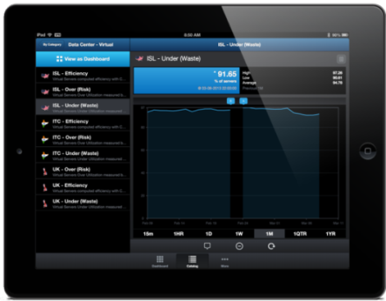
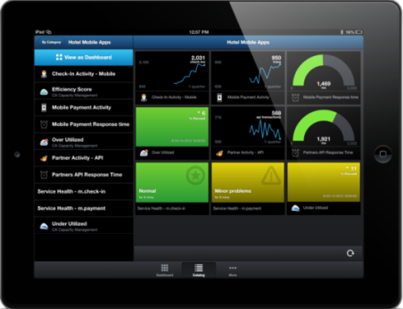
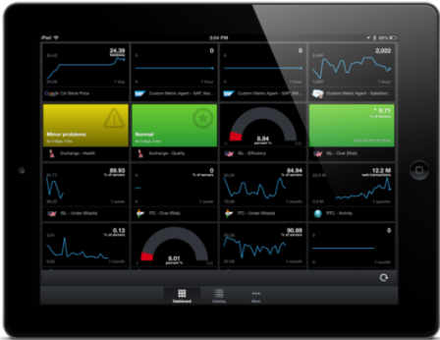
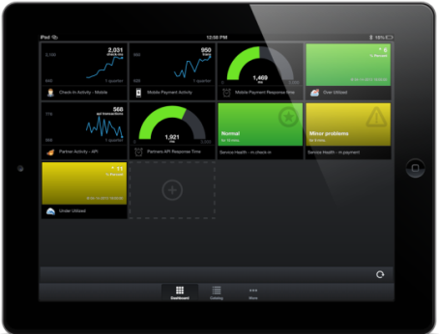
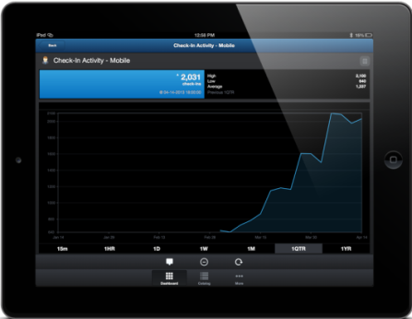
CA Application Performance Management (APM) Acceleration Services: Executive Dashboards
Visualization Real-time health, performance for key IT Services
Designed with you in mind C-Level managers, active users
Insight into high-value metrics
Measure pulse of business for key applications, infrastructure
View on mobile devices
Underpinned by CA Executive Insight for Service Assurance (CA Executive Insight)
Notes:
Enabling Acceleration Services
The APM Solution Offering, together with CA’s collection of Service Assurance solutions, extends the value of CA solutions and solution offerings, and we are always expanding and improving upon integrations. Three main integrations, which are independent of each other, are as follows:
CA Infrastructure Management (IM) Integration Acceleration Services
This acceleration service provides visibility into network device performance, and provides native multi-tenancy capability from the ground up. It provides visibility and increased control of the monitored infrastructure responsible for delivery of mission critical applications.
CA Service Operations Insight (SOI) Integration Acceleration Services
CA SOI integration acceleration services extend the capability of foundation services to provide you with real-time views of service status so you can pinpoint, prioritize and resolve across the IT supply chain. This helps to minimize risks to the business, improve service quality and predictability, and optimize operational efficiency.
CA Application Delivery Analysis Integration Acceleration Services
CA Application Delivery Analysis passively monitors every TCP application packet traversing the network between clients and services, and provides metrics that include network, server, and application latency for all mission-critical applications to provide optimal application delivery.

Slide 11

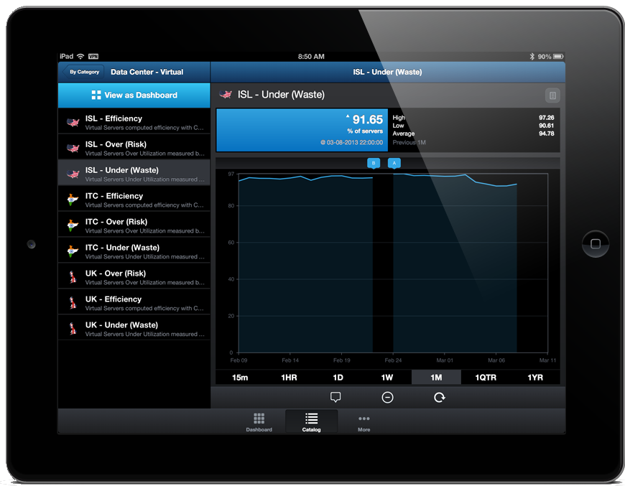

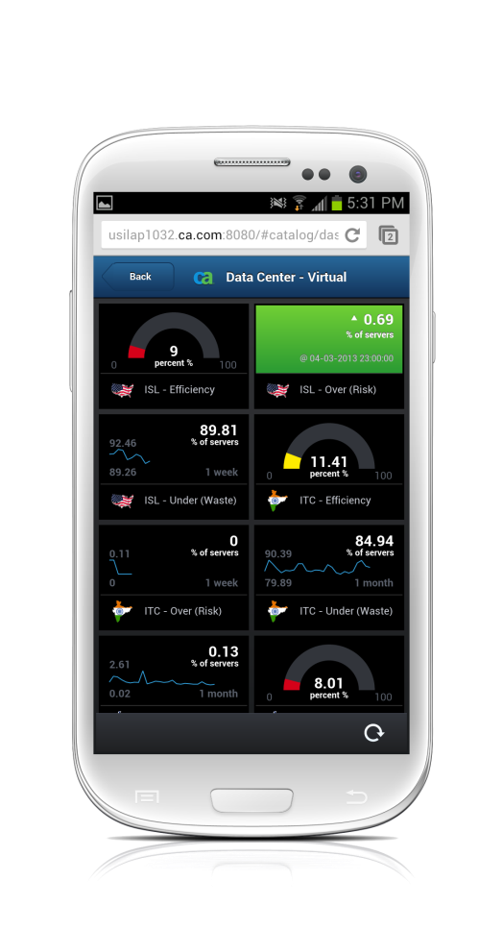
CA Application Performance Management (APM) Acceleration Services: Executive Dashboards Detail
Real-time – Anywhere
Application Performance
Capacity Analytics
Energy Analytics
Service Analytics
Universal Adaptors
Interactive HTML5 Experience across Multiple Platforms

Slide 12
CA Application Performance Management (APM) Acceleration Services: Enabling
CA Executive Insight Integration | Designed to provide executives with a mobile platform to view the key performance indicators relating to the health of their key IT Services
CA Service Operations Insight (SOI) Integration | Real-time views of service status to pinpoint, prioritize. resolve across IT supply chain Help minimize risks Improve service quality and predictability Optimize operational efficiency
CA Application Delivery Analysis Integration | Passively monitors every TCP application packet traversing the network between clients and services Provides metrics that include network, server, and application latency for all mission-critical applications Help provide optimal application delivery
Notes:
Enabling Acceleration Services
The APM Solution Offering, together with CA’s collection of Service Assurance solutions, extends the value of CA solutions and solution offerings, and we are always expanding and improving upon integrations. Three main integrations, which are independent of each other, are as follows:
CA Infrastructure Management (IM) Integration Acceleration Services
This acceleration service provides visibility into network device performance, and provides native multi-tenancy capability from the ground up. It provides visibility and increased control of the monitored infrastructure responsible for delivery of mission critical applications.
CA Service Operations Insight (SOI) Integration Acceleration Services
CA SOI integration acceleration services extend the capability of foundation services to provide you with real-time views of service status so you can pinpoint, prioritize and resolve across the IT supply chain. This helps to minimize risks to the business, improve service quality and predictability, and optimize operational efficiency.
CA Application Delivery Analysis Integration Acceleration Services
CA Application Delivery Analysis passively monitors every TCP application packet traversing the network between clients and services, and provides metrics that include network, server, and application latency for all mission-critical applications to provide optimal application delivery.

Slide 13
CA Application Performance Management (APM) Acceleration Services: Functionality Enhancements w/PWP’s
Deeper functionality to built-in features of CA APM solution accelerators:
Deliver new integration
Enhance functionality
Provide industry-specific configurations
Augment analytic capabilities with powerful report libraries and dashboards
CA HTTP Session Monitor | Determines, load tests and provides data to help balance the memory used by HTTP sessions Fine-tune performance of a CA APM deployment
Deployment Pack for CA Introscope with Citrix | Facilitate monitoring of performance data of Citrix appliances and services deployed Coupled with CA Introscope Investigator or WebView, provides additional metrics about Citrix ecosystem.
Deployment Pack for CA APM with IBM WebSphere DataPower | Facilitates performance data monitoring of IBM WebSphere DataPower appliances and services deployed
Synthetic User Field Pack for CA APM | Provides linkage in CA Introscope between an individual virtual user session and executed backend code Supports both Java and .NET agents
Notes:
Adds more depth of functionality to the built-in features of CA APM solution accelerators.
These enhancements offer benefits like delivering new integration, enhancing functionality that provides value to new users and additional audiences, providing industry-specific configurations, and augmenting analytic capabilities with powerful report libraries and dashboards.

Slide 14
CA Application Performance Management (APM) Acceleration Services: Functionality Enhancements w/PWP’s
Deployment Pack for CA APM with IBM AS/400 | Provides iSeries/AS400 monitoring based on the CA APM Environment Performance Agent, and using AS/400 monitoring standards.
Deployment Pack for CA APM with Windows PerfMon | Regularly polls for performance metric from Windows PerfMon API that can be used for alerts, or to create a custom dashboard in the CA APM workstation.
Business Activity Monitoring Plug-In for CA CEM | Provides a workflow-based activity tracking for each step of every user session and feeds it, in real time, into CA APM for statistical analysis.
CA GD Deployment Pack for SAP ABAP | Fetches data remotely from ABAP and the SAP instance, then pushes this data to CA Introscope Enterprise Manager. Deployment pack uses the JCO Client library, developed by SAP, to connect and retrieve data published by ABAP.

Slide 15
CA Services can help.
Notes:
No matter what your desired business outcomes are and the technology that you choose to help you get there, CA Services can help you plan the best strategy for implementing the solution.

Slide 16



Implement CA Application Performance Management with CA Services
Consult
Implement
Assessments
People & Process
Packaged Work Products
Cloud
Compass
Service
Design
Acceleration Services
Foundation Services
Optimization
On-Premise
SaaS
Hosted
PLAN
BUILD
RUN
Notes:
Just like we are platform agnostic, we are also delivery model agnostic. We don’t care if you choose a on-premise solution, a SaaS solution, or a hosted solution (from CA Services or someone else).
We can help you to plan it – with our consultation services.
When you are implementing a new solution, the technology integration can be easier than people and process change. You may have IT operating models and processes that were developed over many years that are not easy to change.
We can help you plan a complete solution by helping you assess the people, process and technology requirements.
Getting full value from your investment doesn’t just rely on implementing new technology.
People need to understand how their functional role and processes are impacted for technology investments to yield results.
If you are like many of our customers, you are asked to justify every IT investment and demonstrate ROI.
We can help you accomplish that when we work together to conduct a full value analysis after the CA Services engagement.
We can also help you build the best solution for your needs with our implementation services – proven, modular solutions that align to your people, process, technology, and budget requirements, while retaining the benefit of defined outcomes that allow for efficient and effective implementation.

Slide 17






How do I train users to fully-leverage CA Application Performance Management?
We make education easy
In order to accommodate your schedule and get your team what they need, we provide a variety of training solutions
Virtual
Web-Based
Classroom
On Site
CA Productivity Accelerator
Instructor led
Virtual labs
Short durations
Available 24/7
Self-led or recorded
Public Schedule
Private Classes
Hands-on labs
Private classes delivered at your site
Customized to meet your needs
Create training, documentation,• and support • materials
13 types of output
Notes:
CA Technologies also offers outstanding education resources for the training and support of your staff who will be responsible for running and operating the environment.
We are strong believers in post-implementation training, and advocate assessing organizational impact in the early stages of your plan so individuals and teams are set up for success after we end our initial engagement.
We will work with you to identify your educational needs, provide a range of flexible learning options, and outline an effective plan to meet your goals.
Our training methods and tools are designed to help teams be more productive in less time so you’ll reach your business goals sooner.

Slide 18
CA Services and Education – the complete solution
Consult
Implement
Run-and-Operate
Assessments
People & Process
Service Design
Optimization
Healthchecks
Foundation Services
Acceleration Services
Packaged Work Products
Knowledge Transfer
Managed support for end users and administrators
Solution administration
Change management
Reporting
Knowledge transfer and training
Consulting and data analysis
On-Premise
SaaS
Hosted
Educate
Education Needs Assessments
Learning Paths
CA Productivity Accelerator
Instructor Led Training (Virtual, Onsite and Classroom)
Web Based Training
On-Site Enablement
Certification
PLAN
BUILD
RUN
Notes:
CA Services is committed to your success with CA Technologies solutions, and to working with you throughout the entire solution lifecycle, from strategy and consulting to implementation and management.
We help you get the most from your solutions by leveraging our deep expertise and years of experience gained from thousands of engagements around the world.
Our consulting services help you find your path and start your journey…and,
Our implementation services get you to your destination with modular and configurable approaches to meet your unique demands.
CA Services delivers unsurpassed depth of expertise for insight and control over technology and deployment efforts, and breadth of services offerings to deliver results with confidence.
Thank you. Questions?

Slide 19
Run-and-Operate Services available for:
Service Portfolio Management | Security | Service Assurance
CA -Service Desk Manager CA Service Catalog CA Clarity PPM | CA IdentityMinder CA GovernanceMinder CA ControlMinder CA SiteMinder | Application Performance Management APM Introscope APM Customer Experience Manager Converged Infrastructure Management CA Spectrum CA Network Flow Analysis CA System Performance for Infrastructure Managers CA Virtual Assurance for Infrastructure Managers CA Application Delivery Analysis CA APM CA NetVoyant CA eHealth Performance Manager CA Nimsoft Monitor CA Service Operations Insight CA Executive Insight

Slide 20



Run-and-Operate Services: Value at a glance
Speed project lifecycle
Gain visibility into network and infrastructure performance
Quickly adapt to changing environments
Add SME to your staff rapidly and consistently
Leverage virtual CA solution expert for your IT staff
Reduce implementation risk and disruption
Maximize resources for more strategic tasks
Boost productivity and resource effectiveness
Financial flexibility
Optimize your software implementation
Improve operations
Reduce costs
Achieve maximum ROI
OPERATIONAL BENEFITS
STAFF BENEFITS
FINANCIAL BENEFITS

Slide 21

The CA Services advantage
Customizable to meet your needs
✔
Flexible engagements to match your changing business
✔
Phased approach
✔
Technology leadership
✔
Best Practices
✔
NO ONE KNOWS CA TECHNOLOGIES LIKE CA SERVICES

Slide 22
Stay Connected with CA Services!
CA Communities enable users to share insights, experience and questions. It’s a great way to get timely information on events, news and solutions, and to network around the world.
CA Services is on Twitter, with constant updates on IT trends, leadership insights, and CA Services news.
CA Communities | CA Application Performance Management Global User Community https://communities.ca.com/web/ca-wily-global-user-community/welcome
Twitter | @CA_Services @CAsvcAssur @SvcAssurLATAM

Slide 23
BACKUP SLIDES

